Slide 1
Implementation of EU Floods directive.
Hydrological and hydraulic modeling for the needs of the Flood Hazard and Flood Risk Mapping in Bulgaria
Vladimir Kukurin, Assist. Prof., PhD. Dipl-Ing
University of Architecture, Civil Engineering and Geodesy – Sofia
Theme-based Staff Training in UACEG.
Reflection of the water policies in the education: insights form the Bulgarian experience
Sofia/ 29-31.05.2019
This project has been funded with support from the European Commission. This publication reflects the views only of the author, and the Commission cannot be held responsible for any use which may be made of the information contained therein.

Slide 2

Department of Hydraulics and Hydrology
Main courses:
  Hydraulics
  Hydrology
  Hydroinformatics
  Fluid mechanics
  Marine hydrodynamics
  River morphology
  Applied informatics in water sector
2 Hydraulic laboratories
  Education
  Science
  Commercial work

Slide 3
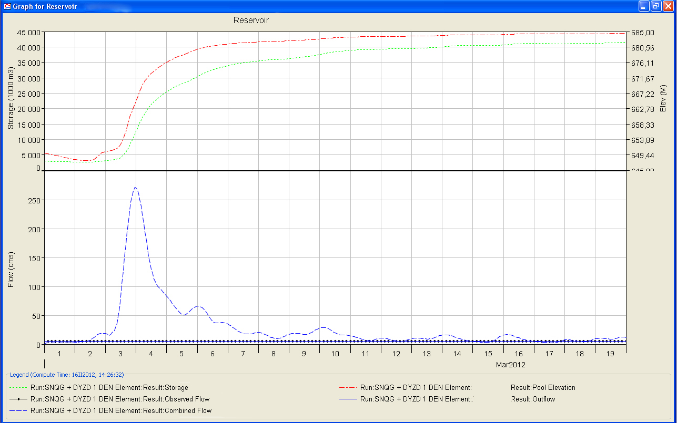
Department of Hydraulics and Hydrology
Hydrological modeling

Slide 4
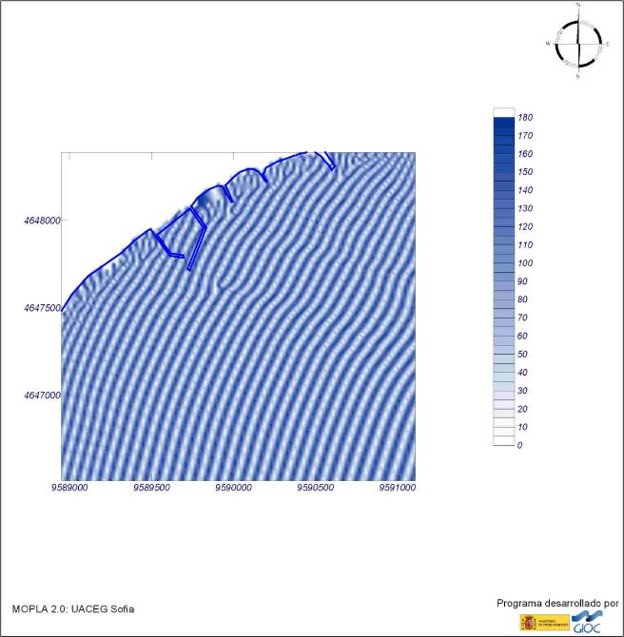
Department of Hydraulics and Hydrology
Numerical modeling of
wave transformation

Slide 5
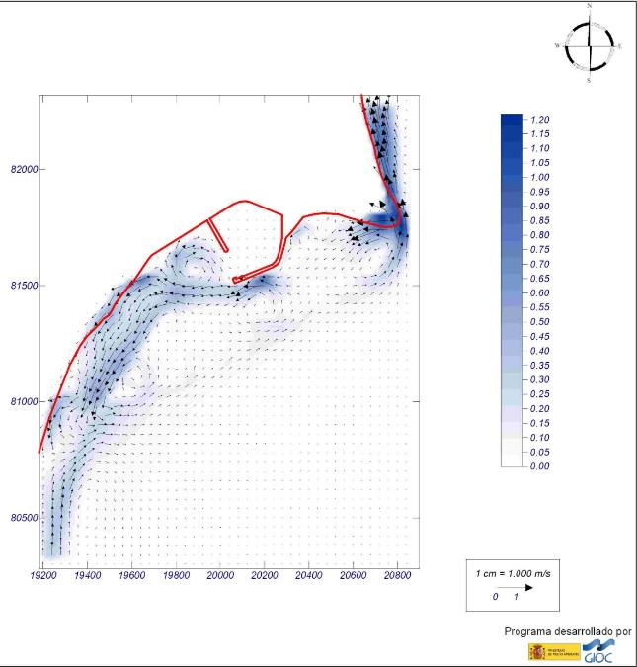
Department of Hydraulics and Hydrology
Numerical modeling of
wave induced currents

Slide 6
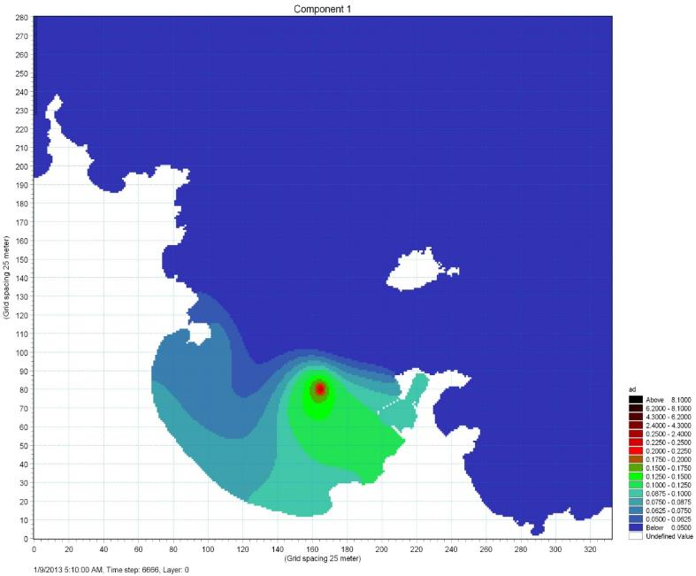
Department of Hydraulics and Hydrology
Numerical modeling of
advection and diffusion

Slide 7
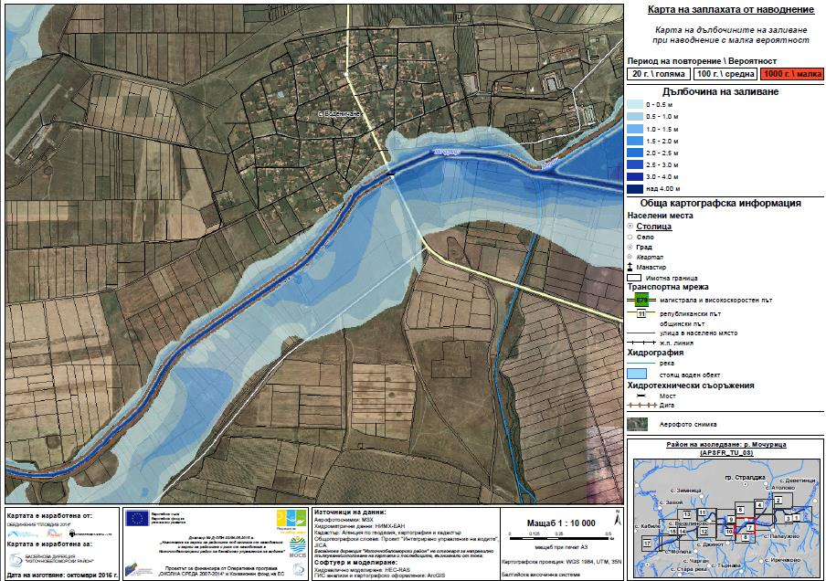
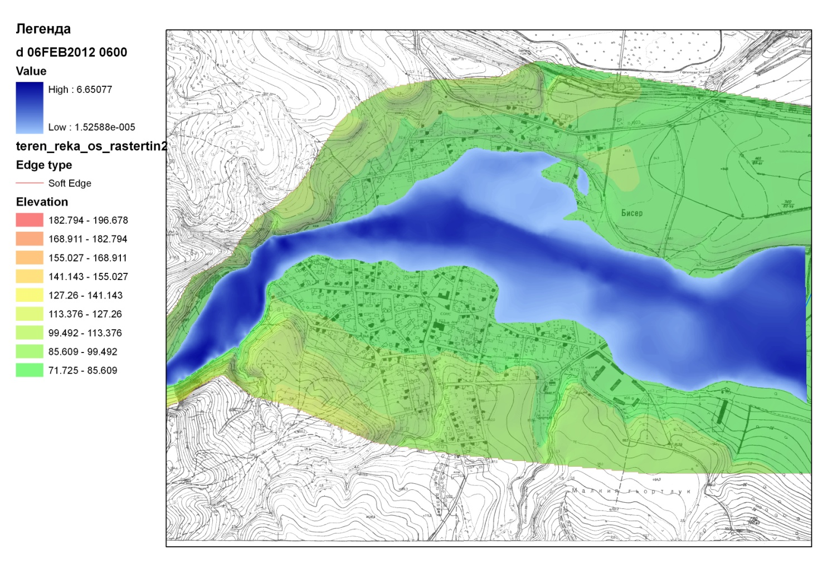
Department of Hydraulics and Hydrology
1D and 2D Numerical modeling of flood waves and dam breach waves

Slide 8
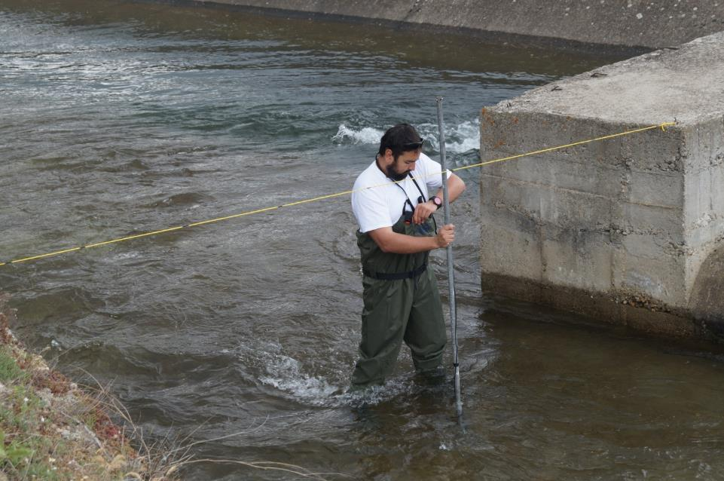
Department of Hydraulics and Hydrology
Field
measurements

Slide 9
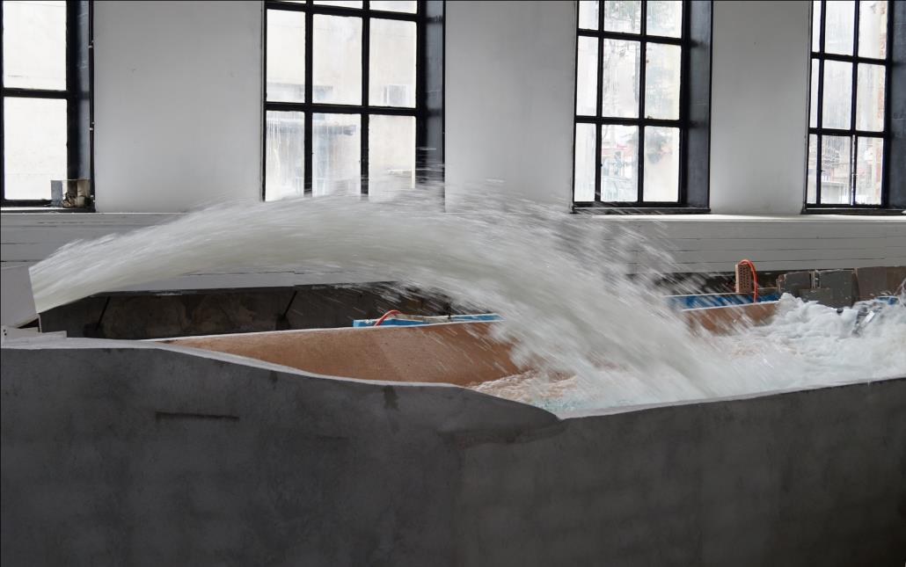
Department of Hydraulics and Hydrology
Physical hydraulic
modeling

Slide 10
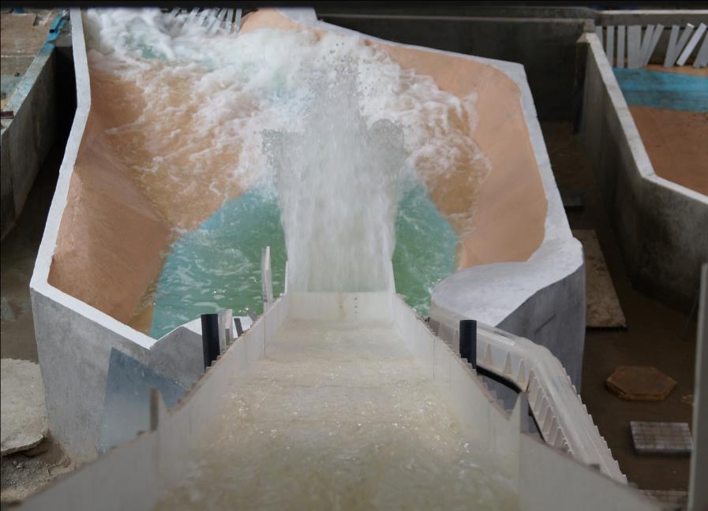
Department of Hydraulics and Hydrology
Physical hydraulic
modeling

Slide 11
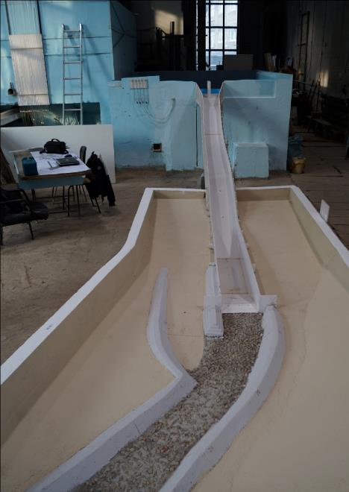
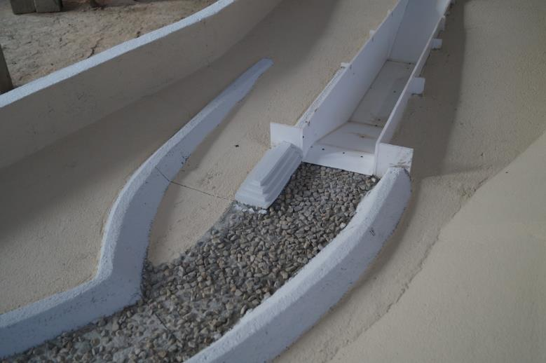
Department of Hydraulics and Hydrology
Physical hydraulic modeling

Slide 12
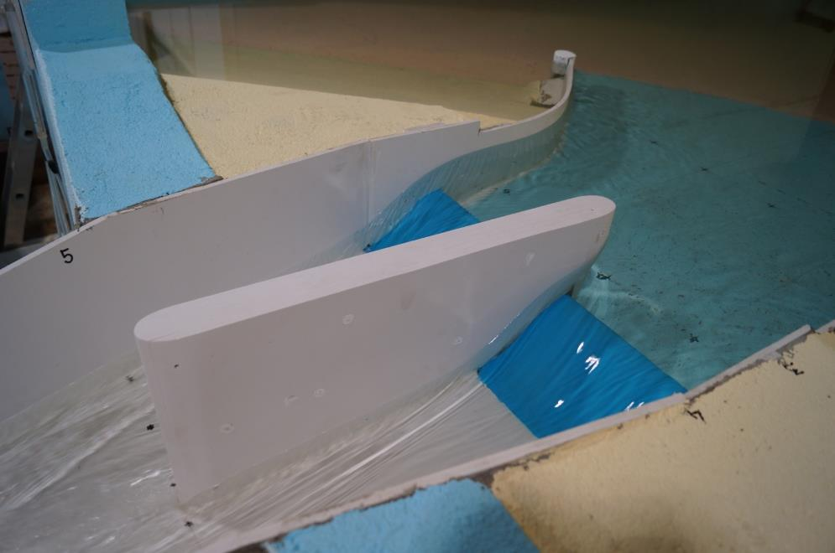
Department of Hydraulics and Hydrology
Physical hydraulic
modeling

Slide 13
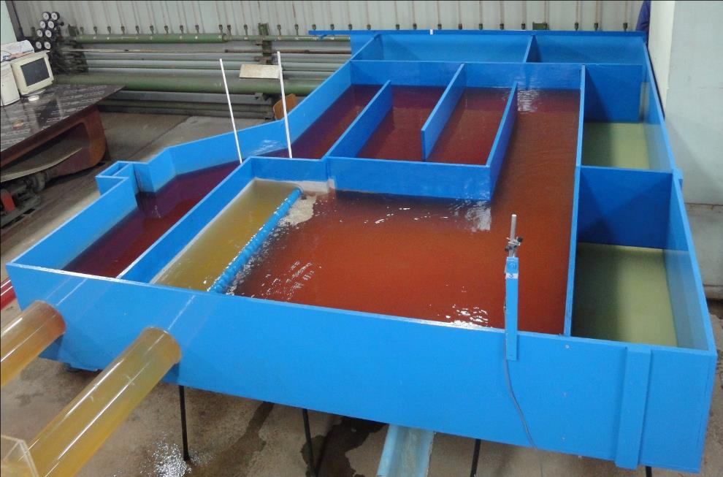
Department of Hydraulics and Hydrology
Physical hydraulic
modeling

Slide 14
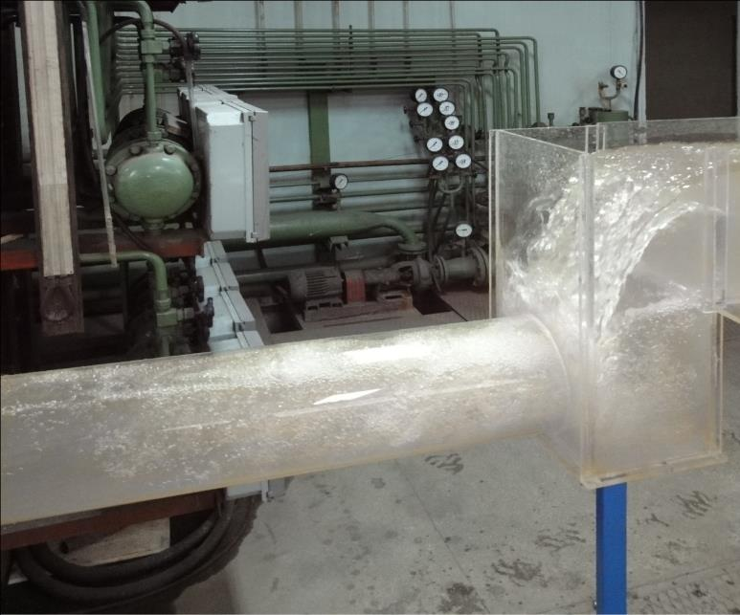
Department of Hydraulics and Hydrology
Physical hydraulic modeling

Slide 15
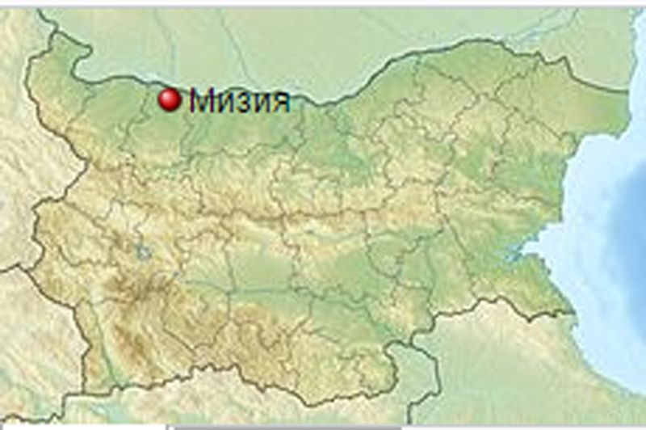
Mizia flood study
The whole city was flooded in
August 2014
The reasons were unclear
  Dams?
  2 broken dams
Discharge?

Slide 16
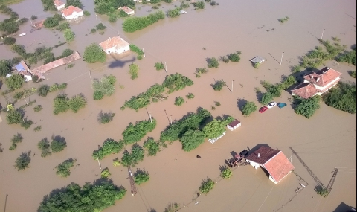
Mizia flood study

Slide 17
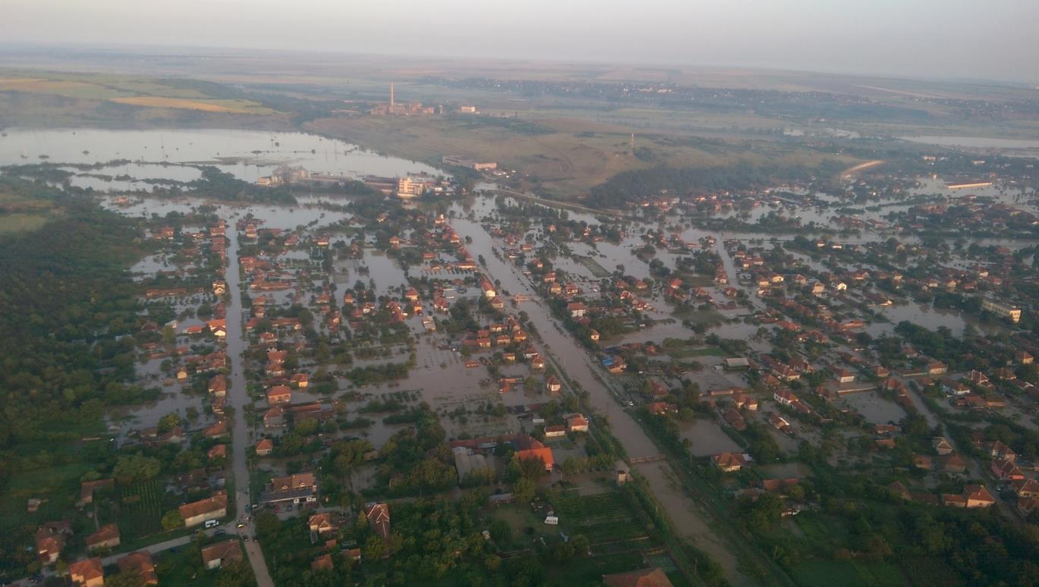
Mizia flood study

Slide 18
Mizia flood study
Hydrological + Hydraulic model study
  Lack of calibration data for both models
Hydrological model
  Rainfall – Runoff model
  HEC - HMS

Slide 19
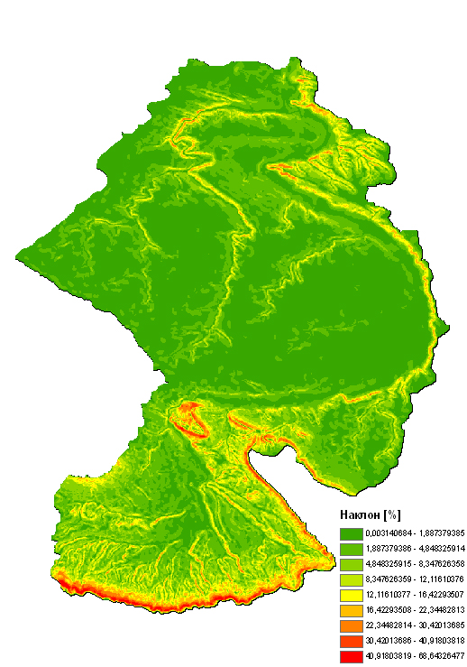
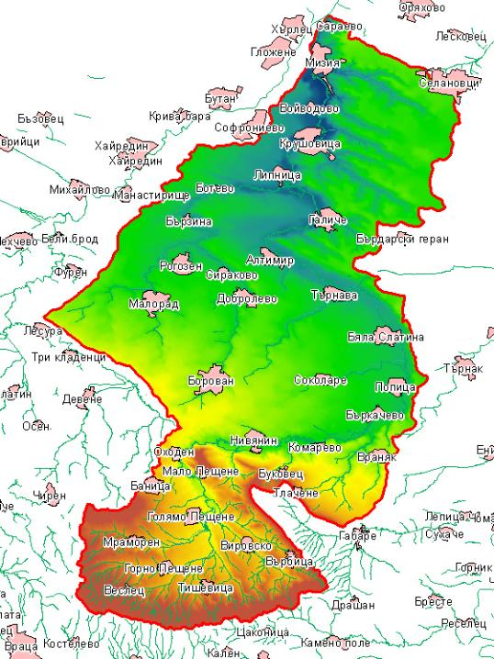
Mizia flood study
DTM
Slope

Slide 20
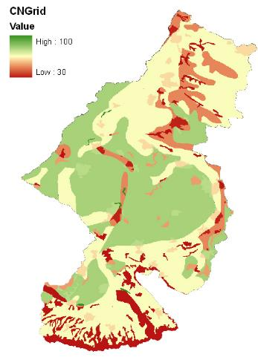
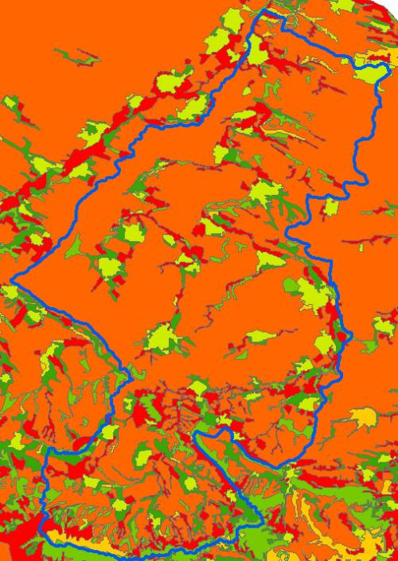
Mizia flood study
Land cover
CN curves

Slide 21
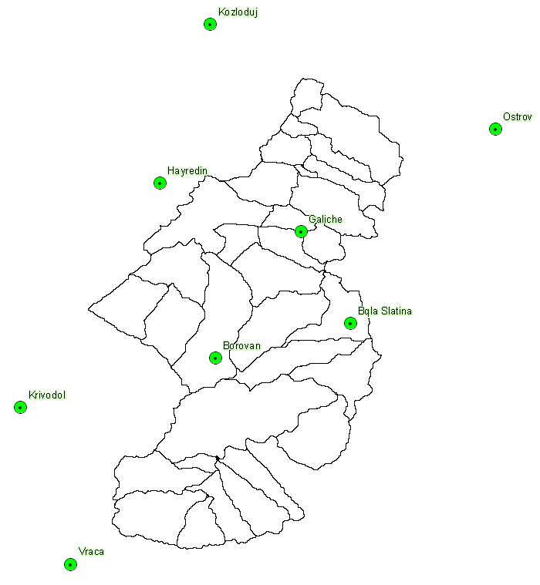
Mizia flood study
Rainfall data:
8 measurement points
  3 points iside the watershed

Slide 22
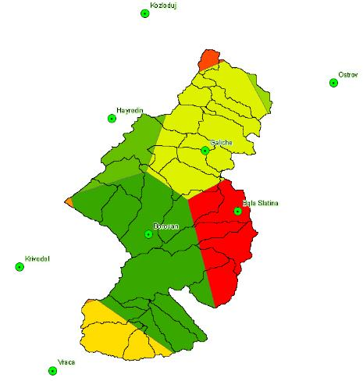
Mizia flood study
Rainfall data:
8 measurement points
  3 points iside the watershed
Thiessen polygons

Slide 23
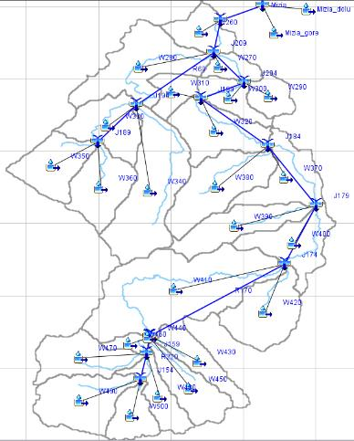
Mizia flood study
Hydrological model:
23 watersheds
1 month simulation period

Slide 24

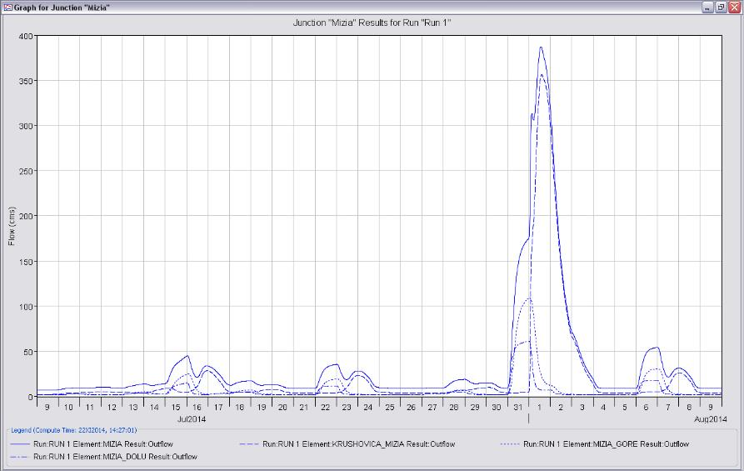
Mizia flood study
Results:
4 points
Flow hydrographs
Q max = 387 m³/s
Flood wave vol.
  ~ 60 Mio. m³

Slide 25
Mizia flood study –
Hydraulic model
Main task:
  To use the available calibration data (water level marks) and to check if they can be reached with the obtained in the hydrological model hydrographs.
  Hydraulic models, involving all 4 output points of the rainfall – runoff model.

Slide 26
Mizia flood study –
Hydraulic model
Methodology of the study
  two hydraulic models
    1D – HEC-RAS v.4.1
    2D – SRH – 2D
  The whole reach was modelled with 1D model
  Additional 2D models were developed for the urban areas

Slide 27
Mizia flood study –
Hydraulic model
Additional analysis of the Terrain models
2 Digital Terrain Models
  by aerial orthophotogrammetry
  by combining of precise geodetic survey of the river bed with digitized topographic maps (1:5000)
Main task:
  To analyze the results of the hydraulic model and to assess if these two fast and cheap methods for DTM generation can be used in praxis

Slide 28
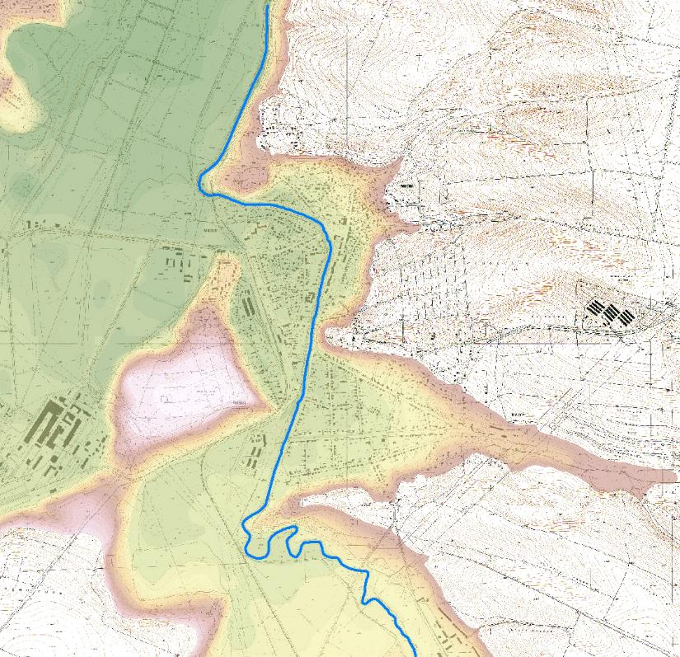
Mizia flood study –
Hydraulic model
Short description of the studied area

Slide 29
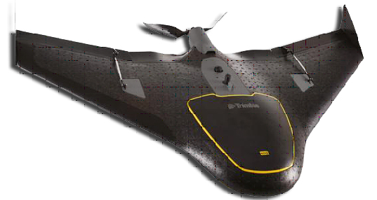
Mizia flood study –
Hydraulic model
Short description of digital terrain models
  Aerial imagery

Slide 30
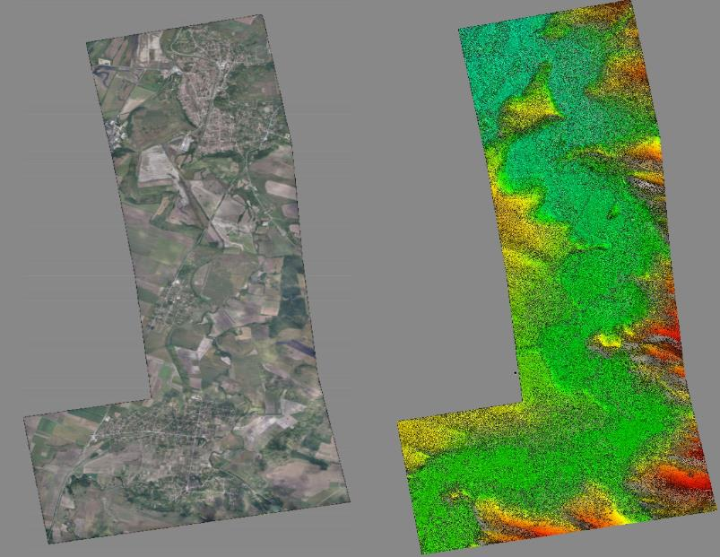
Mizia flood study –
Hydraulic model
Short description of digital terrain models
  Aerial imagery
    DSM with resolution
      0.917 x 0.917 m

Slide 31
Mizia flood study –
Hydraulic model
Short description of digital terrain models
  Detailed geodetic survey + digitized topomaps

Slide 32
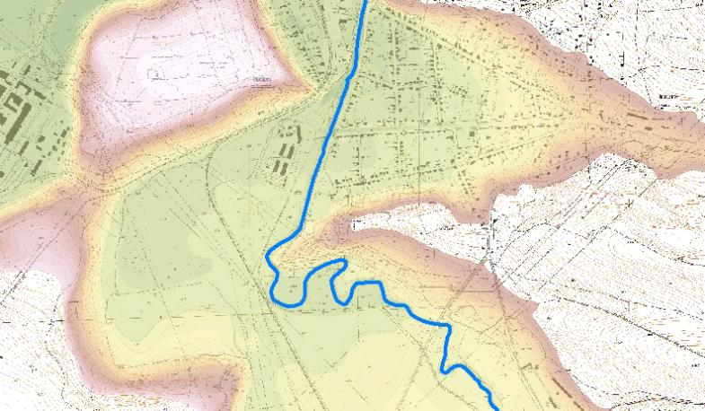
Mizia flood study –
Hydraulic model
DTM with resolution
1 х 1 м

Slide 33
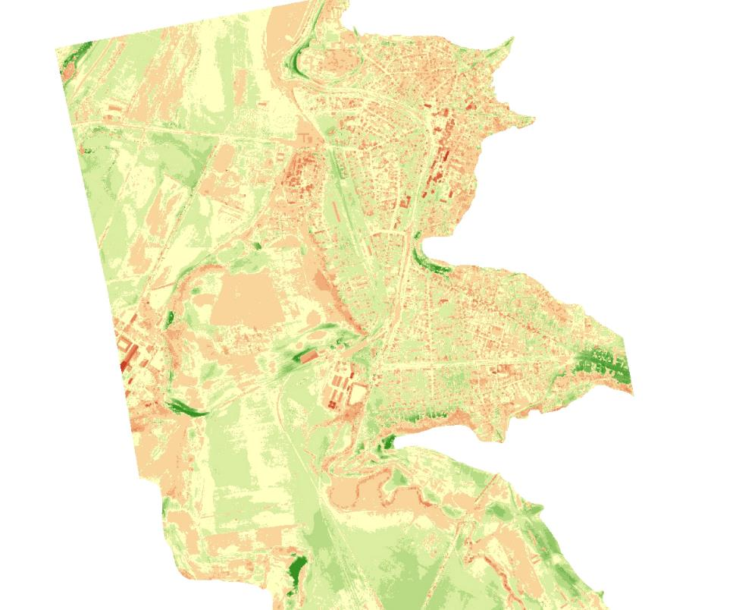
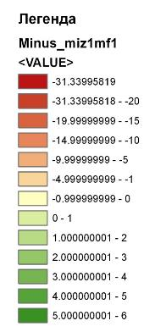
Mizia flood study –
Hydraulic model
Comparison between both DTMs

Slide 34
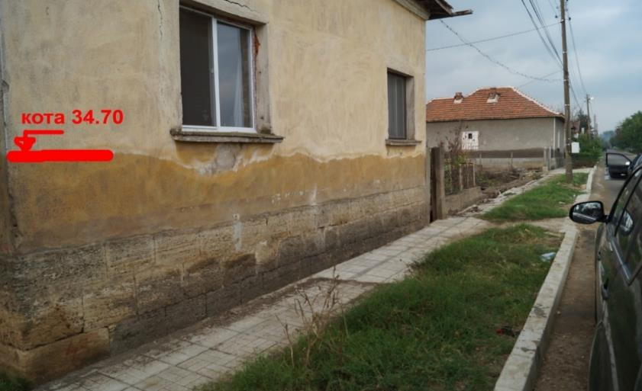
Mizia flood study –
Hydraulic model
Building of the hydraulic models
  1D hydraulic model
    231 detailed cross sections
    Manning’s n values – according literature data and calibrated for the Mizia flood in 2014
  Boundary conditions

Slide 37
Mizia flood study –
Hydraulic model
Building of the hydraulic models
  2D hydraulic model
    only in the urban areas
    only with DTM, obtained with survey data + topomaps
    Variable size flexible mesh

Slide 38
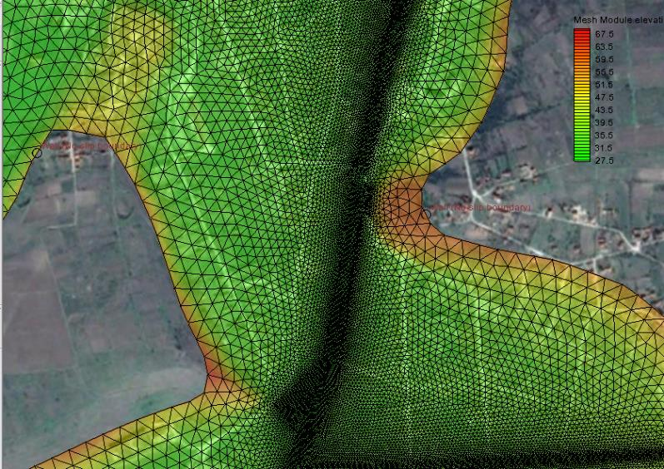
5.5 Построяване на хидравличните модели
  Двудименсионален хидравличен модел

Slide 39
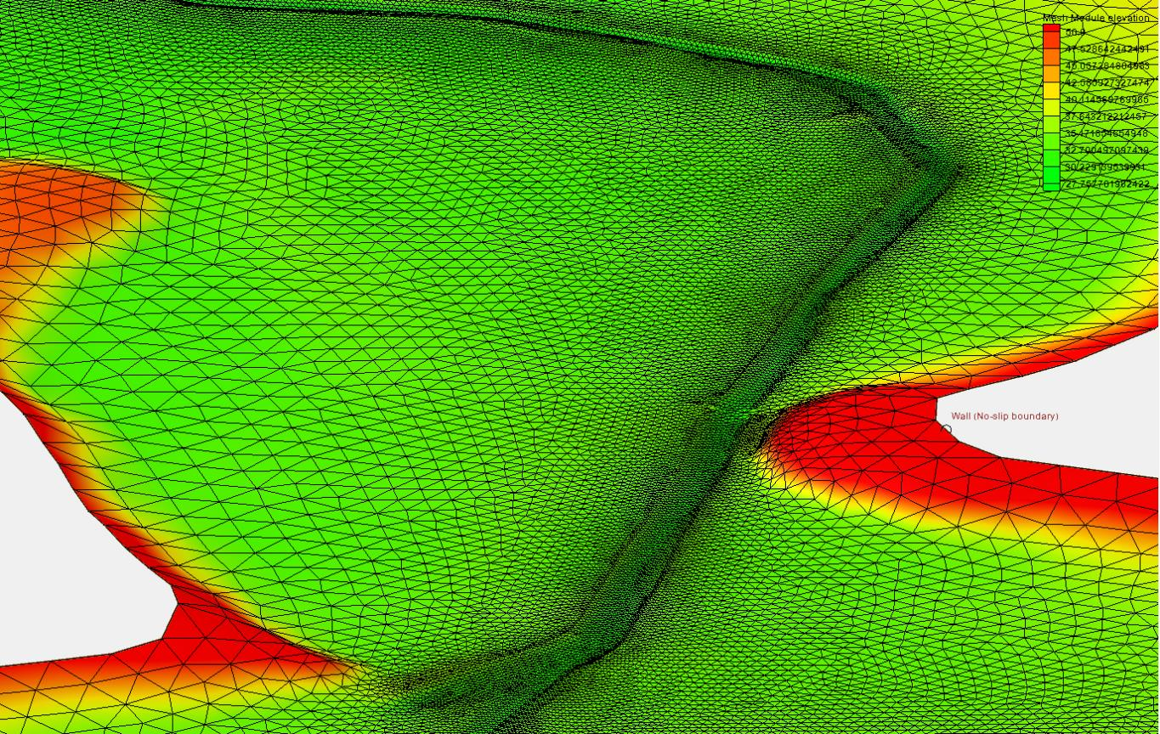
5.5 Построяване на хидравличните модели
  Двудименсионален хидравличен модел

Slide 40
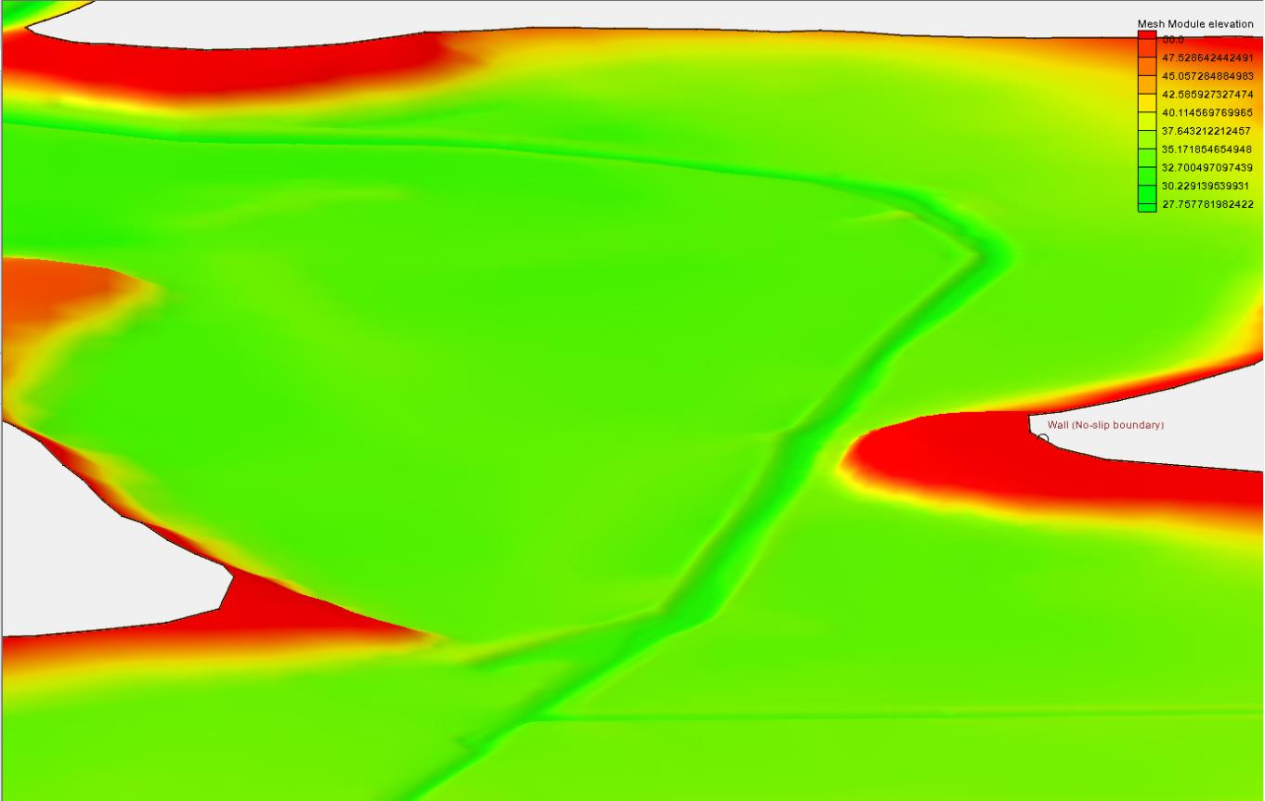
5.5 Построяване на хидравличните модели
  Двудименсионален хидравличен модел

Slide 41
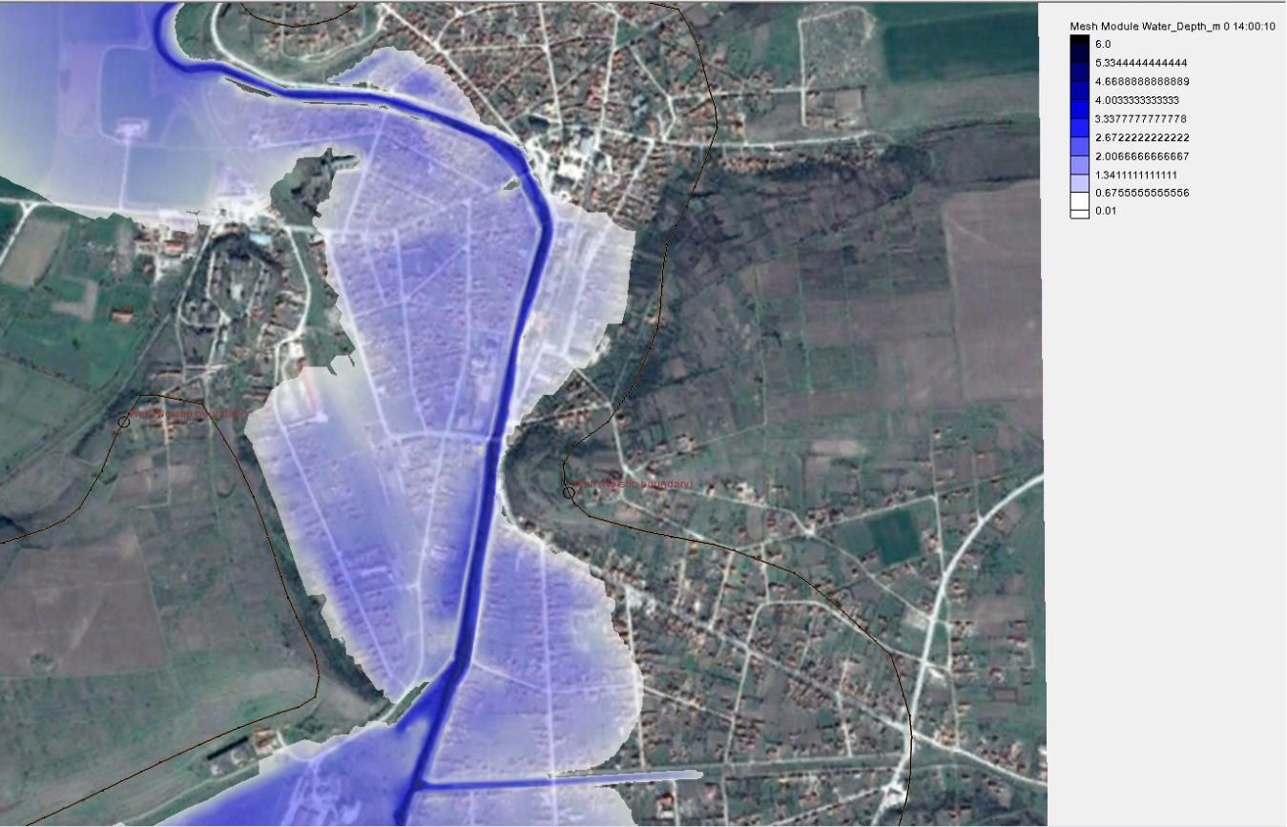
5.5 Построяване на хидравличните модели
  Двудименсионален хидравличен модел

Slide 42
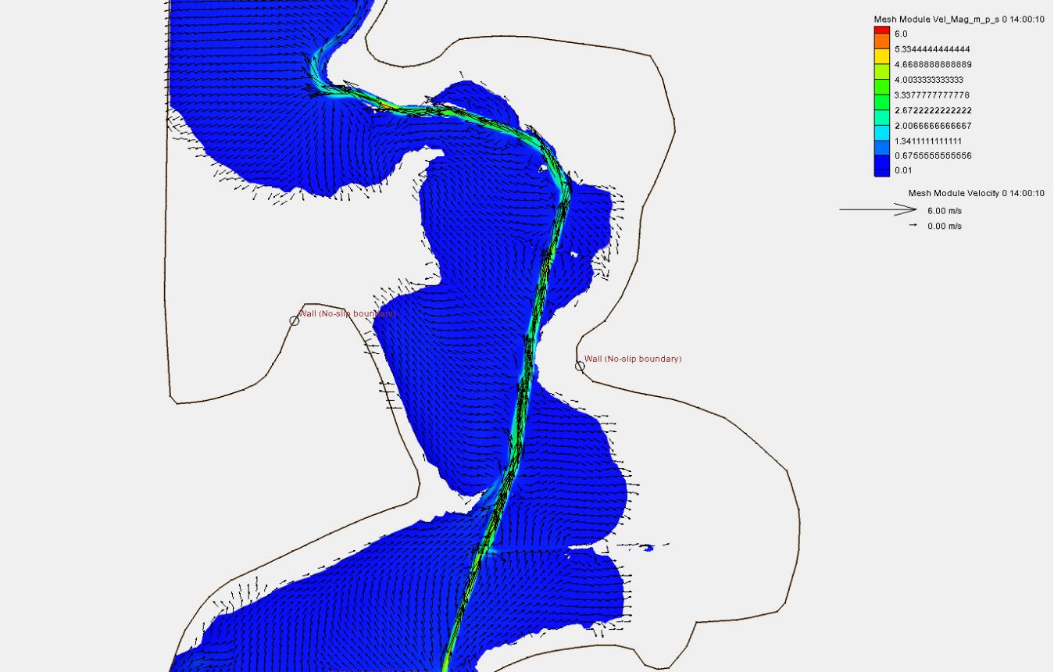
5.5 Построяване на хидравличните модели
  Двудименсионален хидравличен модел

Slide 43
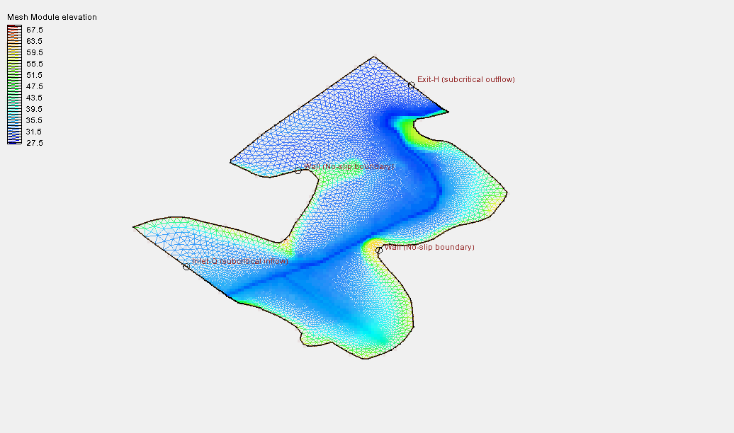

Slide 44
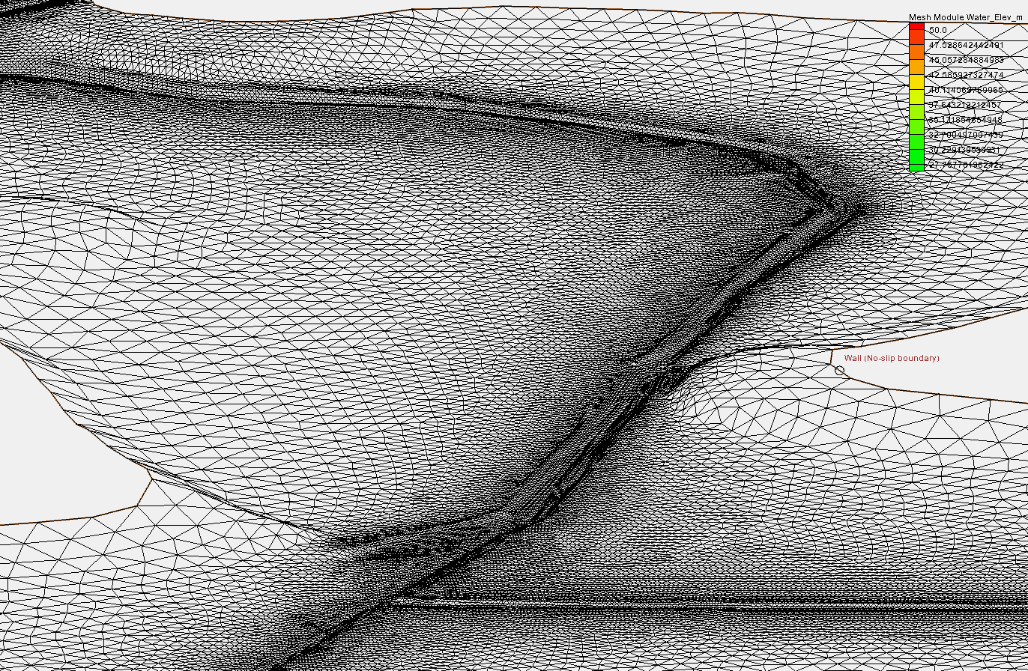

Slide 45
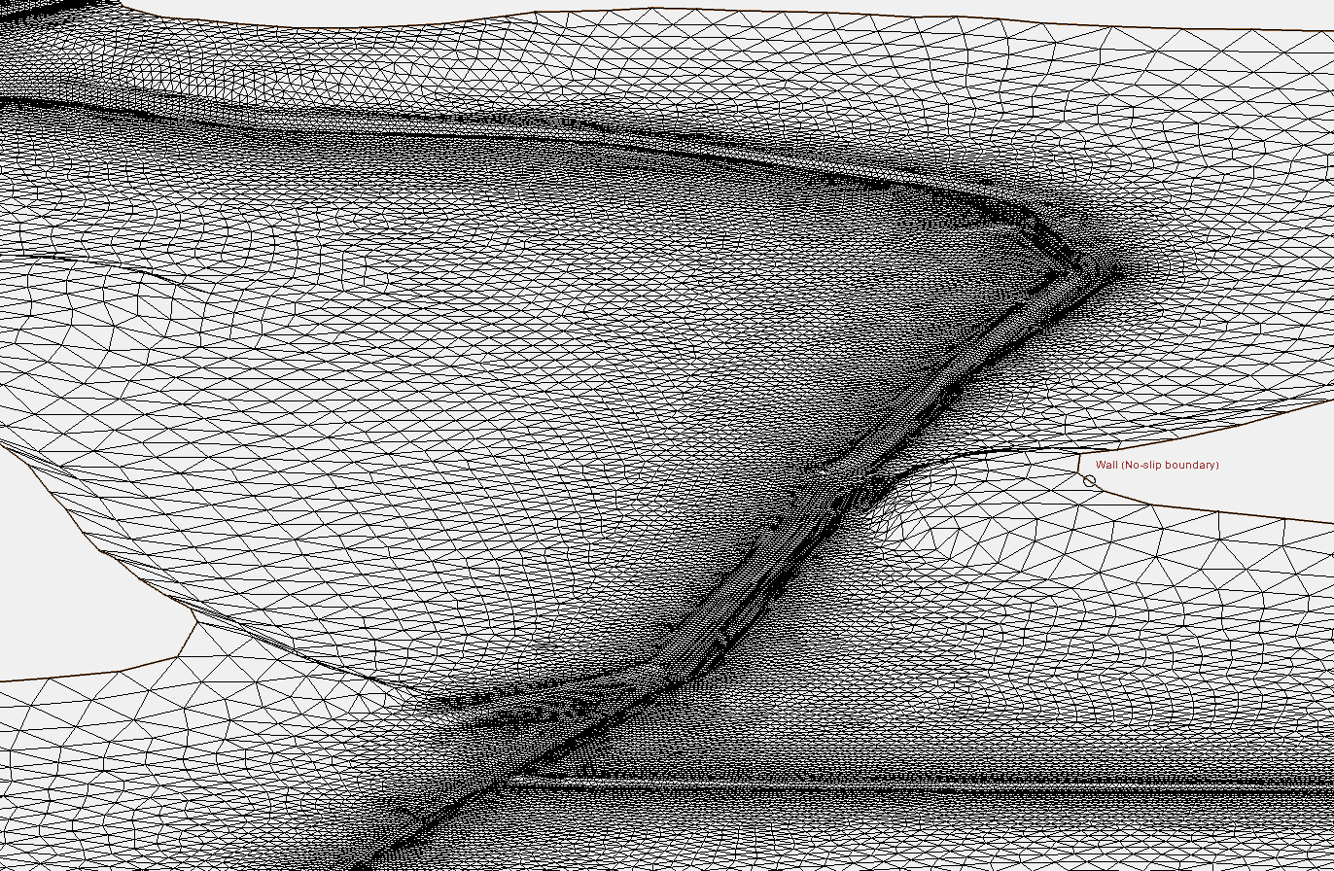

Slide 46
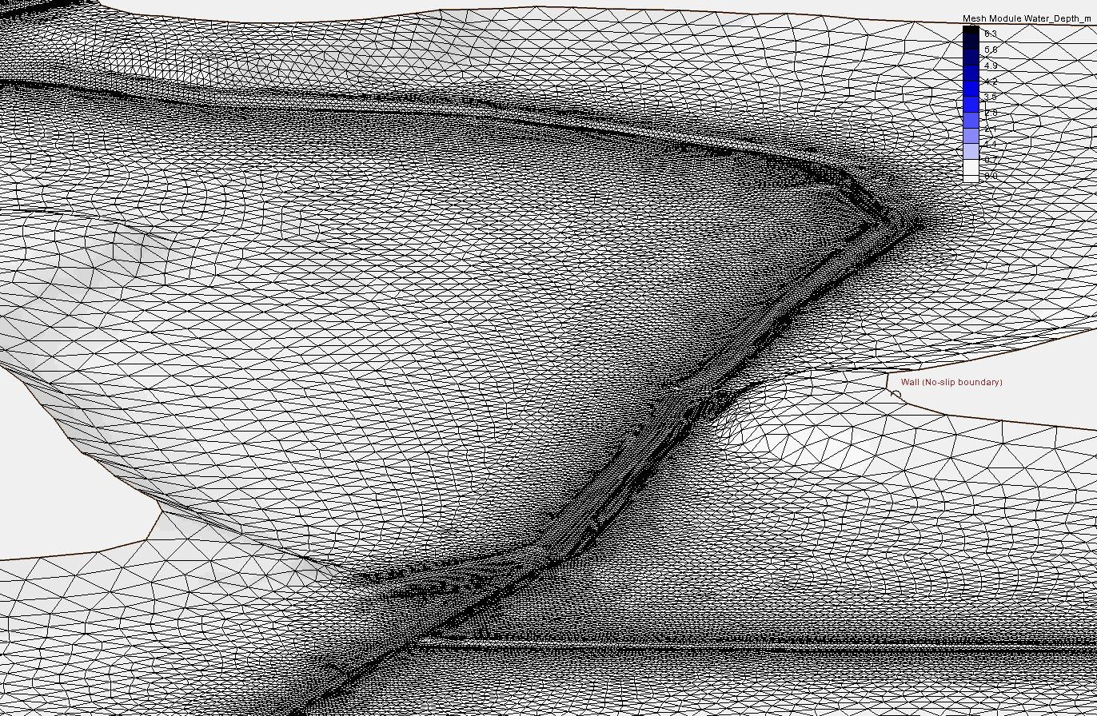

Slide 47
Mizia flood study –
Conclusions
The calculated hydrograph is realistic
  The calculated flood is very close to the observed
The maximum discharge is approx. 380 m³/s
(vs. 1000 m³/s – officially reported)
The volume of the flood wave is approx.
60 Mio. m³
(The volume of all reservoirs in the watershed is approx. 250 000 m³)

Slide 48
THANK YOU FOR YOUR KIND ATTENTION!
Vladimir Kukurin, Assist. Prof., PhD. Dipl-Ing
e-mail: v.kukurin@gmail.com
v_kukurin@yahoo.com
Tel: +359 2 963 52 45/662
Mobile: +359 887 975331

